Slide 1
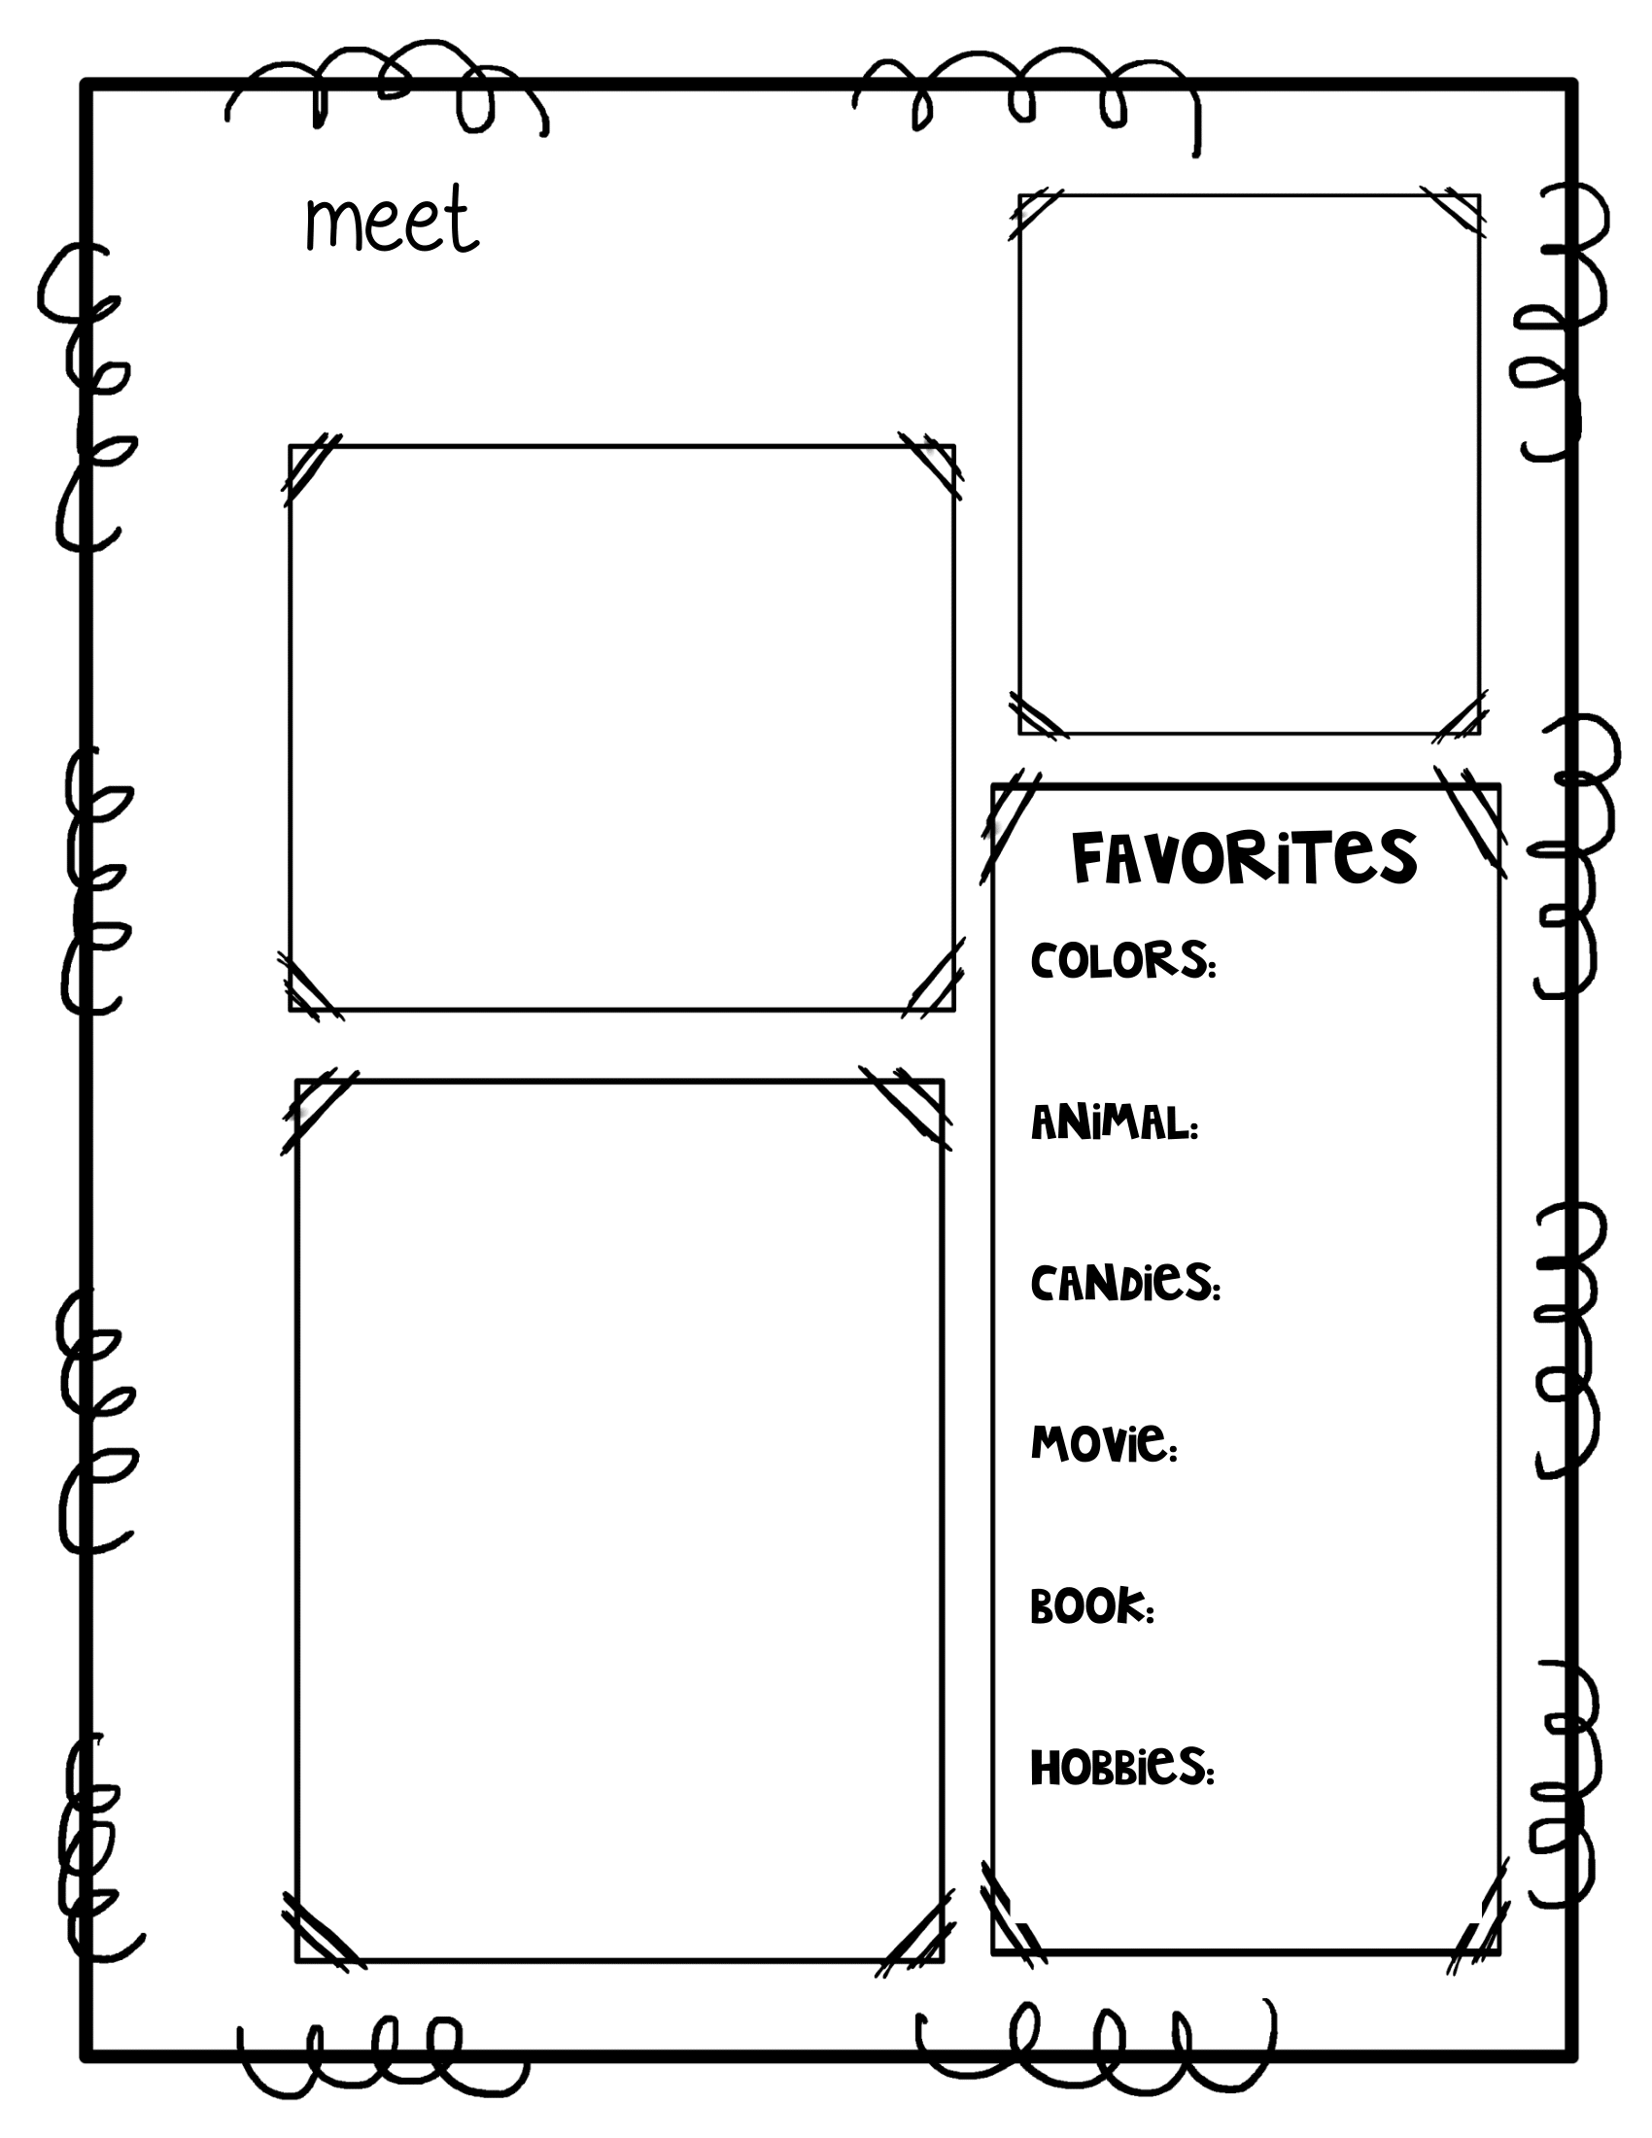
Ms. Weber
SPECIAL EDUCATION
Welcome to the 2024-25 school year!!
I am a Case Manager and Resource Teacher @ Markham Park and Nob Hill Elementary Schools.
Green & Purple
Contact info
Email: tweber@phsd144.net
Phone:
Markham Park
(708)210-2869 (ext 2208)
Nob Hill
(708) 335-9770 (ext 2717)
Monkey
Caramel
Cinderella
Letters to a Young Poet
Cooking & Crafting

